Slide 1


AUDIO SENTIMENT ANALYSIS
NATIONAL INSTITUTE FOR TECHNOLOGY KARNATAKA, SURATHKAL INDIAN SOCIETY FOR TECHNICAL EDUCATION, NITK CHAPTER
Project Mentors:
Prerana Prakash
Vanessa Fernandes
Malvika Koushik
Project Mentees:
Swati Agarwal
Urvesh
Hemant Somanna
Ainesh Sinha
Garvit Goyal
Prateek Rajput
+91 95670 97555 | https://iste.nitk.ac.in | iste@nitk.edu.in
+91 9611343895 | www.istenitk.com | istenitkchapter@gmail.com

Slide 2

INTRODUCTION
NATIONAL INSTITUTE FOR TECHNOLOGY KARNATAKA, SURATHKAL INDIAN SOCIETY FOR TECHNICAL EDUCATION, NITK CHAPTER
Sentiment Analysis is the study of people’s emotion or attitude towards a event, conversation on topics or in general.
Sentiment analysis is used in various applications, here we use it to comprehend the mindset of humans based on their conversations with each other.
+91 95670 97555 | https://iste.nitk.ac.in | iste@nitk.edu.in
+91 9611343895 | www.istenitk.com | istenitkchapter@gmail.com

Slide 3
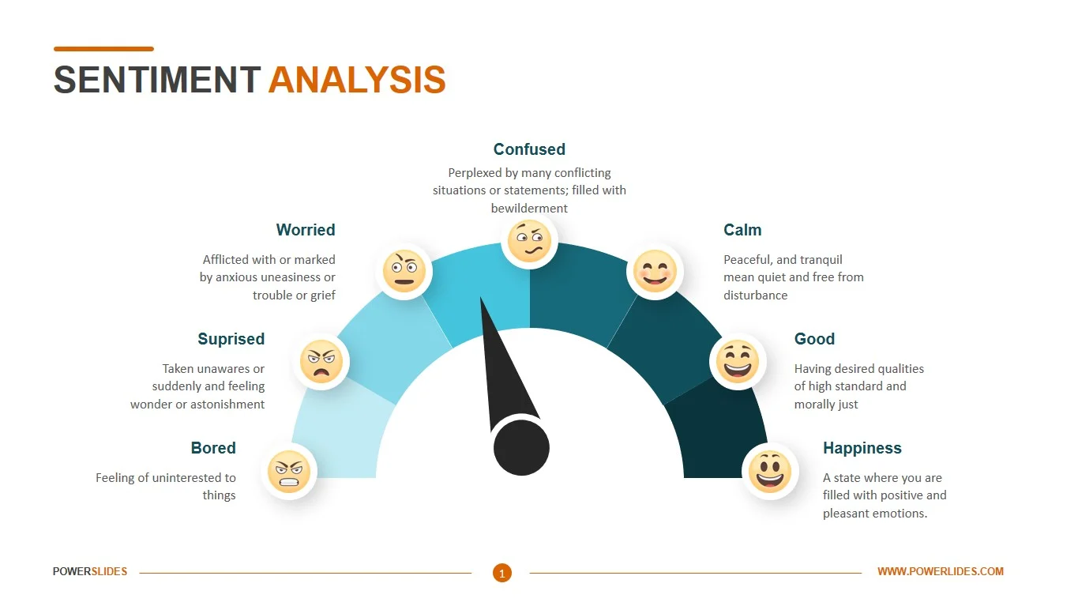
AIM
NATIONAL INSTITUTE FOR TECHNOLOGY KARNATAKA, SURATHKAL INDIAN SOCIETY FOR TECHNICAL EDUCATION, NITK CHAPTER
To perform sentiment analysis on basis of audio clips using machine learning algorithms, specifically CNN, LSTM and SVM and compare accuracies of results obtained using all three models.
+91 95670 97555 | https://iste.nitk.ac.in | iste@nitk.edu.in
+91 9611343895 | www.istenitk.com | istenitkchapter@gmail.com

Slide 4
PROCEDURE
NATIONAL INSTITUTE FOR TECHNOLOGY KARNATAKA, SURATHKAL INDIAN SOCIETY FOR TECHNICAL EDUCATION, NITK CHAPTER
Choosing RAVDESS dataset for the model training. The RAVDESS is a validated multimodal database of gender balanced emotional speech and song. Speech includes calm, happy, sad, angry, fearful, surprise, neutral and disgust expressions.
Build an audio sentiment analysis model using CNN on RAVDESS dataset
Add live prediction for voice data
Build an web app for recording audio
Integrate the model with the website for live sentiment prediction
+91 95670 97555 | https://iste.nitk.ac.in | iste@nitk.edu.in
+91 9611343895 | www.istenitk.com | istenitkchapter@gmail.com

Slide 5
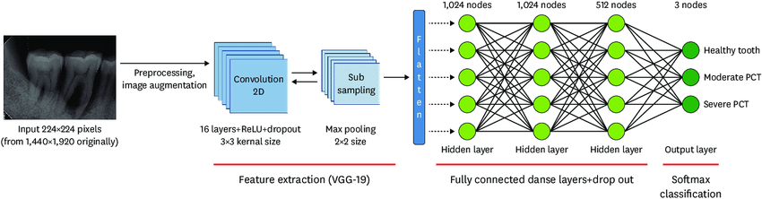
NATIONAL INSTITUTE FOR TECHNOLOGY KARNATAKA, SURATHKAL INDIAN SOCIETY FOR TECHNICAL EDUCATION, NITK CHAPTER
CNN MODEL ARCHITECTURE
+91 95670 97555 | https://iste.nitk.ac.in | iste@nitk.edu.in
+91 9611343895 | www.istenitk.com | istenitkchapter@gmail.com

Slide 6
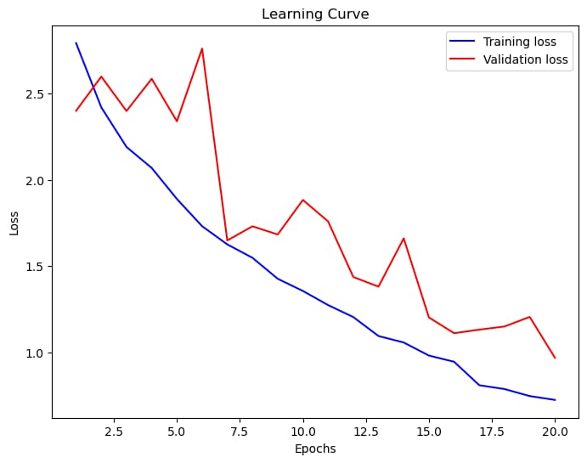
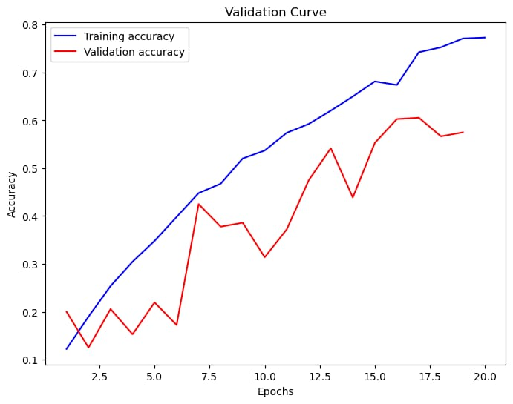
NATIONAL INSTITUTE FOR TECHNOLOGY KARNATAKA, SURATHKAL INDIAN SOCIETY FOR TECHNICAL EDUCATION, NITK CHAPTER
Validation and Learning Curve of Model
+91 95670 97555 | https://iste.nitk.ac.in | iste@nitk.edu.in
+91 9611343895 | www.istenitk.com | istenitkchapter@gmail.com

Slide 7
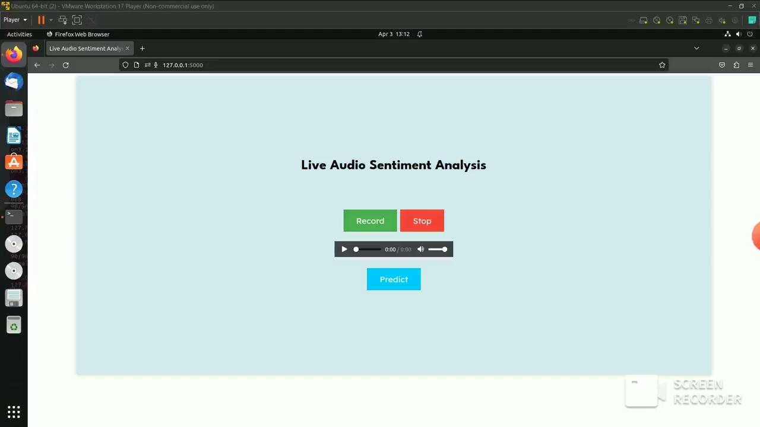
NATIONAL INSTITUTE FOR TECHNOLOGY KARNATAKA, SURATHKAL INDIAN SOCIETY FOR TECHNICAL EDUCATION, NITK CHAPTER
+91 95670 97555 | https://iste.nitk.ac.in | iste@nitk.edu.in
+91 9611343895 | www.istenitk.com | istenitkchapter@gmail.com

Slide 8
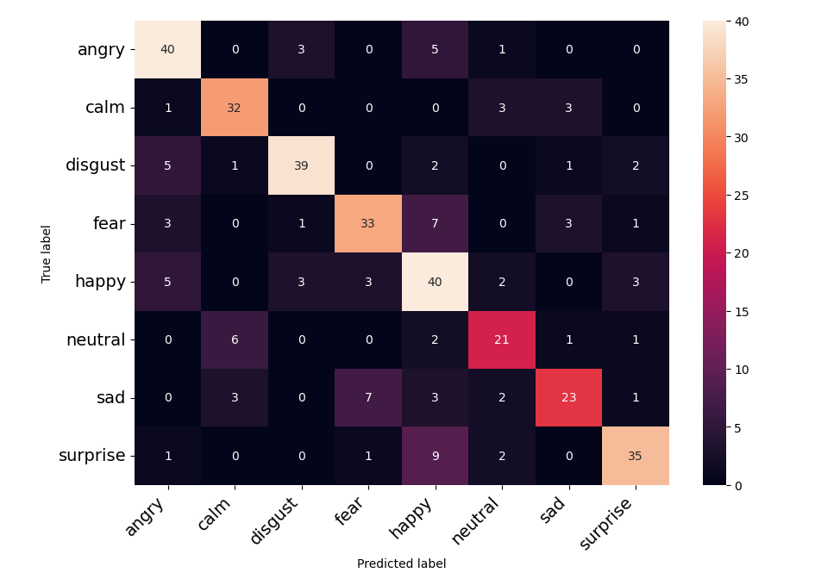
NATIONAL INSTITUTE FOR TECHNOLOGY KARNATAKA, SURATHKAL INDIAN SOCIETY FOR TECHNICAL EDUCATION, NITK CHAPTER
RESULTS
Live Audio Sentiment Analysis achieved with
an accuracy of 73%
+91 95670 97555 | https://iste.nitk.ac.in | iste@nitk.edu.in
+91 9611343895 | www.istenitk.com | istenitkchapter@gmail.com

Slide 9

NATIONAL INSTITUTE FOR TECHNOLOGY KARNATAKA, SURATHKAL INDIAN SOCIETY FOR TECHNICAL EDUCATION, NITK CHAPTER
+91 95670 97555 | https://iste.nitk.ac.in | iste@nitk.edu.in
+91 9611343895 | www.istenitk.com | istenitkchapter@gmail.com

